Slide 1

CREDIT CARD FRAUD DETECTION
https://doi.org/10.30534/ijeter/2021/02972021
DMT Minor Project Review On
Presented By
171FA04511
171FA04512
171FA04517

Slide 2
Abstract
With the advent improvement of technology most of the people are using online transactions to transfer the money from one person to another person. Credit Card Fraud is the rising problem in the financial department.
The Credit Card Fraud Detection project is developed to spot whether a new transaction is fraudulent or not by checking the past credit card transactions with the knowledge of the previous data like fraud transactions which have happened earlier.
Techniques like Decision Tree, Logistic Regression, SVC and Naïve Bayes are the classification algorithms to detect the non-fraud and fraud transactions.
More numbers of people are using the credit card for shopping, e-commerce and even for education purposes also. Therefore, banks and financial institutions offer credit card fraud detection applications much value and demand.

Slide 3
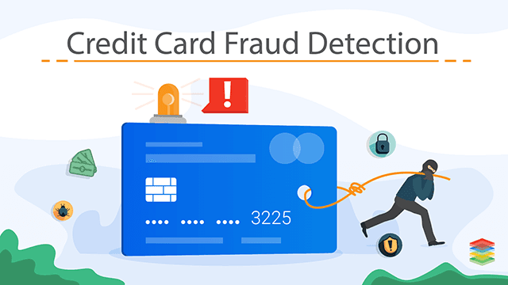
Introduction

Slide 4
Introduction
Credit card fraud is an illegal activity which the fraudsters/hackers do in order to steal money from us using the least effort.
In offline frauds the fraudster just needs to know the pin number associated with our card.
Online fraud can be easily accomplished by knowing the phone number linked to card or sending malware links false promising money in lakhs or crores.

Slide 5
Motivation
Online credit card frauds are a growing concern in todays world as they take place unnoticed by the customers and result in huge losses.
As there are multiple sources of storing money such as virtual debit cards, credit cards, UPIs etc, the frauds also grow accordingly.
Hence, the demand for an appropriate, efficient and on-time delivery based fraud detection system is of utmost importance.
Our project draws its inspiration from modern techniques like Data Mining, Machine Learning etc.

Slide 6
Related Work
In this Project we have performed the data normalization before performing the cluster analysis and classification.
The purpose of data normalization is to bring the data into a single and scalable format.
Normalization may involve various methods such as min-max, decimal scaling, Z-score etc.
Our project ran using different unsupervised algorithms such as DBSCAN, K-Means, Random Forest, Naïve Bayes etc. While DBSCAN showed a mere accuracy of 0, logistic regression turned out to be highly accurate with accuracy of 0.9.
In our case supervised algorithms were fruitful.

Slide 7
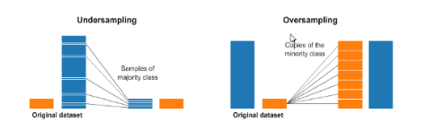
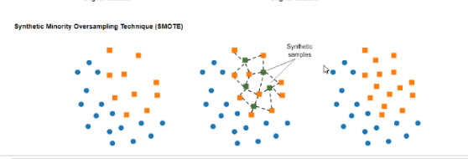
Sampling the Dataset

Slide 8
Proposed System : Methods
Logistic Regression
Decision Tree (J48)
Support Vector Machines
Random Forest
K-Nearest Neighbours
DB-SCAN
K-Means

Slide 9
Proposed System Architecture
Credit card fraud detection system
Select Model
Training data
Testing data
Compare performance measures

Slide 10
Proposed System Architecture
Anomaly detection
Satisfying
Unsatisfying
Positive vote
Select another model and repeat process.

Slide 11
Experimental Results
SNO | Algorithm | Precision | Recall | F1-Score
1 | Random Forest | 0.9583 | 0.7718 | 0.8550
2 | Naïve Bayes | 0.0573 | 0.8389 | 0.1073
3 | Logistic Regression | 0.8785 | 0.6308 | 0.7343
4 | Decision Tree(J48) | 0.6966 | 0.8321 | 0.7584

Slide 12
Experimental Results
S. No | Algorithm | Accuracy
1 | Random Forest | 0.99958
2 | Logistic Regression | 0.99927
3 | Naïve Bayes | 0.9778
4 | Decision Tree | 0.99915
5 | SVC | 0.99935
6 | DBSCAN | 0.00093
7 | K-Means | 0.45828
Table : Results of different algorithms

Slide 13
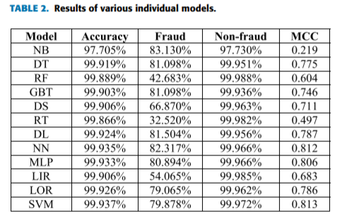
Experimental Results of previous Contributions:

Slide 14
Experimental Results
S. No | Algorithm | Accuracy
1 | Decision Tree (J48) | 99.921%
2 | Naïve Bayes | 99.6254%
3 | Random Forest | 99.9463%
Table : Results using Weka Explorer

Slide 15
Discussion
The combination of multiple algorithms commonly known as ensemble techniques are widely used to improve overall accuracy.
The highest F1-score was shown by random forest approach which proves the above point.
The combination of many algorithms to form a majority voting kind of decision making approach based on results from different algorithms turned out to be really fruitful.

Slide 16
Conclusion
There is no one perfect approach in terms of offering reliability, efficiency and time conservative nature in fraud detection systems.
Although supervised approaches guarantee accuracy, they are not suitable in a world where data varies in a span of minutes or even seconds.
So may be unsupervised techniques may be real life applicable.
While unsupervised algorithms are more flexible they can’t guarantee accuracy, so it’s difficult to resort to a single method.
There are many modern day approaches to this project which we have not tried such as neural networks, AI, Adaboost, XGBoost etc.

Slide 17
References
Navanshu Khare, Saad Yunus Sait, Credit Card Fraud Detection Using Machine Learning Models and Collating Machine Learning Models, International Journal of Pure and Applied Mathematics (IJPAM),Volume 118 No.20 2018,ISSN:1314-3395, www.ijpam.eu.
Dushyant Singh, Saubhagya Vardhan, Dr.Neha Agrawal, Credit Card Fraud Detection Analysis, International Research Journal of Engineering and Technology (IRJET), Volume 5 Issue:11,Nov 2018,ISSN:2395-0056,www.irjet.net.
Devi Meenakshi.B, Janani.B, Gayatri.S, Indira.N, Credit Card Fraud Detection Using Random Forest, International Research Journal of Engineering and Technology (IRJET),Volume :6 Issue:3, March2019,ISSN:2395-0056, www.irjet.net.
Priyanka Yadav, Pavan Wangade, Manish Thakur, Mohammed Fakih, Gayatri Hegde, Proposed Distributed Data Mining In Credit Card Fraud Detection, International Research Journal of Engineering and Technology (IRJET),Volume :3 Issue: 4,April 2016,ISSN:2395-0056, www.irjet.net.
Anuruddha Thennakoon, Chee Bhagyani, Sasitha Premadasa, Shalitha Mihiranga, Nuwan Kuruwitaarachchi, Real Time Credit Card Fraud Detection Using Machine Learning, IEEE, July 2019. INSPEC Accession Number: 18868933.
Dinesh L.Talekar, K.P.Adhiya, Credit Card Fraud Detection System, International Journal of Modern Engineering Research (IJMER),Volume:4 Issue:9,Sept 2014,ISSN:2249-6645, www.ijmer.com.

Slide 18
Dataset and Paper Links
https://www.kaggle.com/mlg-ulb/creditcardfraud
https://doi.org/10.30534/ijeter/2021/02972021

